Slide 1
Terms of use
Do
Terms of Use
*Make as many hard copies as you like for your OWN classroom
*Share online with YOUR OWN students or families in a secure, private platform.
• Share Power Point TM or Google Slides TM as a Tier 1 intervention with students you work with directly.
• Give credit to Pawsitive School Counselor as the author
. DO NOT
• Upload resource to a public website (your school website,. FB, any social media account,. Etc.)
• Share with your school and district- they need to buy their own additional license.
• Email to co-workers for their own use. Send them my TPT link to buy their own license.
• Use parts of this resource to create your own resource or use on Outschool

Slide 2
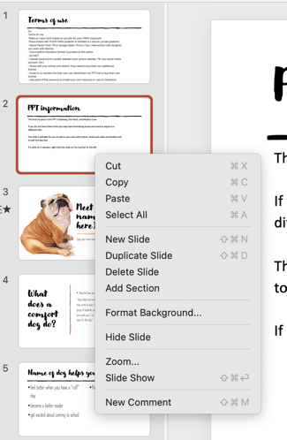
PPT information
The font included in this PPT are Raleway, the Hand, and Modern Love.
If you do not have these fonts, you may have formatting issues and need to adjust to a different font.
You can add your own information by editing the slides. Read each slide and double-click to edit the text box.
If a slide isn’t relevant, right-click it on the toolbar to the left and click "hide slide."

Slide 3
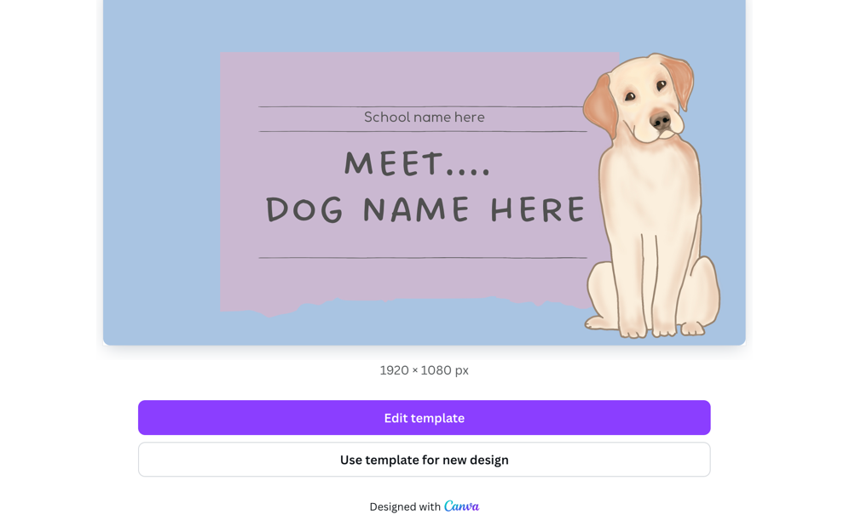
Canva link
Click here for a Canva link for an editable
“Meet the Dog” presentation.
DO NOT click edit template.
Click “use template for your own design to make a copy

Slide 4
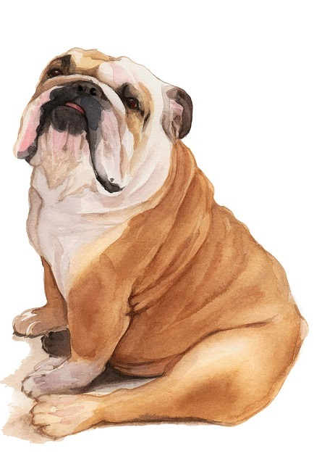
Meet (type name of dog here)
Type your name and school here

Slide 5
What does a comfort dog do?
Describe how you will use your dog here, for ex.
“ Boss helps his mom, your school counselor, by visiting our school. He may come to your class to visit and learn, be with you in a small group of students practicing what we have learned in class, or spend time with you 1 on 1 . You may also see us as you come into school or leave for the day.”

Slide 6
Name of dog helps you
feel better when you have a “ruff” day
become a better reader
get excited about coming to school
Picture here

Slide 7
(Name of dog here)
LIKES:
Add picture here
Pets on their chest
Create a list of what your pet likes here
Belly rubs
Ear scratches

Slide 8
(Name of dog here)
Does NOT like:
Add picture here
Having his feet touched
Create a list of what your pet likes here
Loud noises
When someone pulls his tail

Slide 9
Dos and Don’ts
Type in any requirements your school or program has here, for example:
When you are with Boss- No snacks!
Go straight back to work after your time with Boss- we can talk about it later
No yelling or screaming when Boss is in the room
Please wash your hands after petting him
Only 2 people can pet him at a time.

Slide 10
What if you see us in the hallway?
This may depend on your school, program, and personal expectations. Here are two examples.
We wish we could stop and snuggle every time, but we can’t.
If you see us in the hallway, you can wave hello or give an air hug but remember to stay with your teacher.
Ask for permission from me/your teacher. If we say ”yes” you can come give him a quick snuggle and pet- he loves saying ”hi.” Then head back your class or get back in line- we will see you soon.

Slide 11
What happens when we come to your class?
Did you know that dogs can learn up to 250 words?
It’s true, and (Name of dog) loves to read!
When we come to your class, you and (name of dog) can practice your reading skills by reading together.
When we come in make sure you are working hard- don’t scream or yell, that could scare him.
We will call you over to our special reading spot. Quietly bring and book and come read with us.
When you are done, quietly go back to work.

Slide 12
What if (name of dog) is in class?
Did you know that dogs can learn up to 250 words?
It’s true, and (name of dog) loves to learn.
When (dog) is in class with us, we need to be good role models by:
Working hard
Whispering
Being mindful about where we are walking

Slide 13
What questions do you have?

